Slide 1
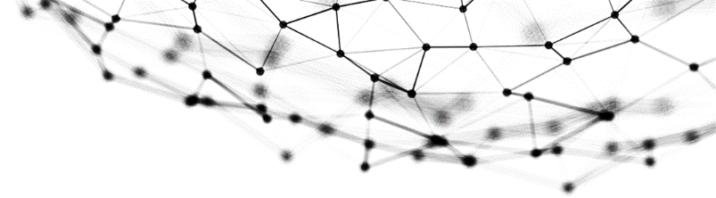


Ethereum smart contract research
Survey shortcomings and propose improvements
F42 - Group Member
HUANG Zheng LUO Suhai
LIN Lixin ZHAO Yuhao
ZHU Jun SHEN Linling

Slide 2
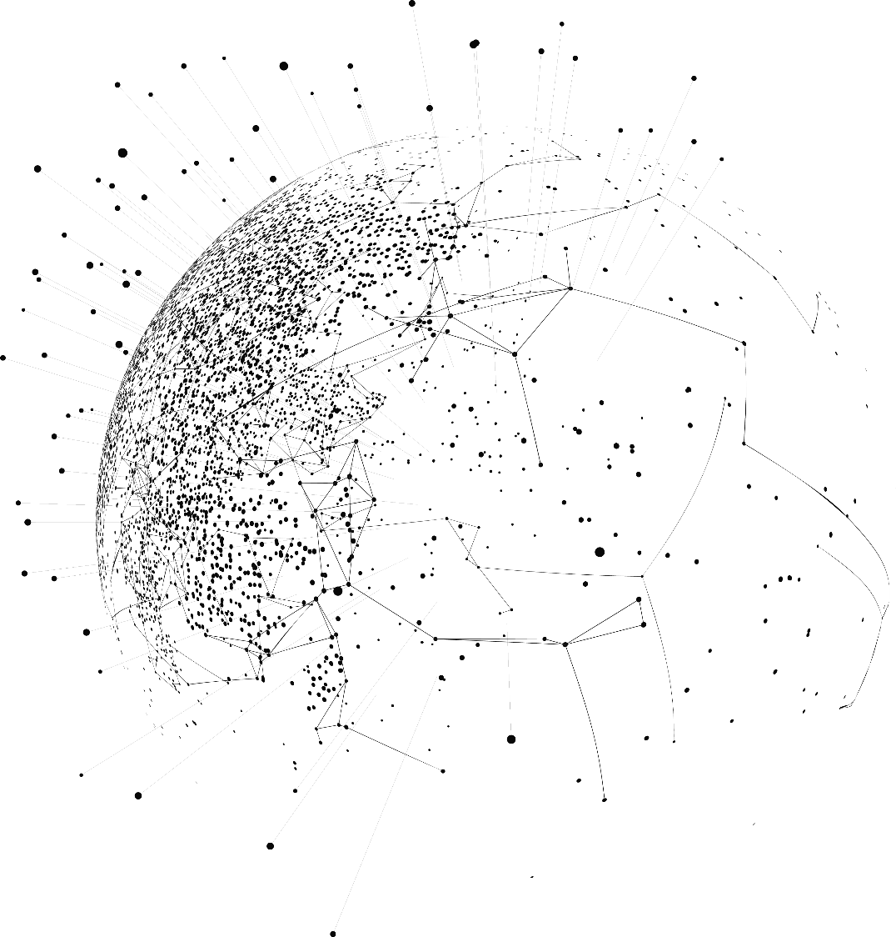
Content
01
Problem definition
& Objectives
02
Solution design
03
Implementation & Deployment

Slide 3
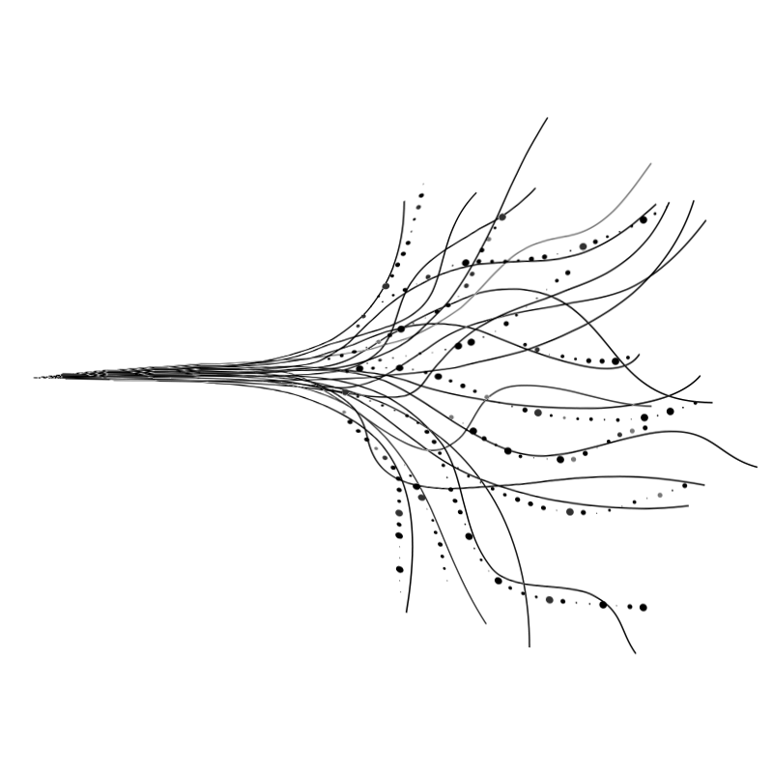
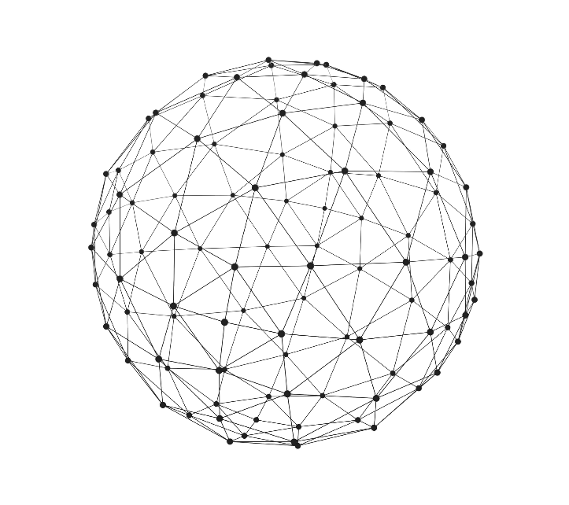
Part 1
Problem definition
& Objectives

Slide 4
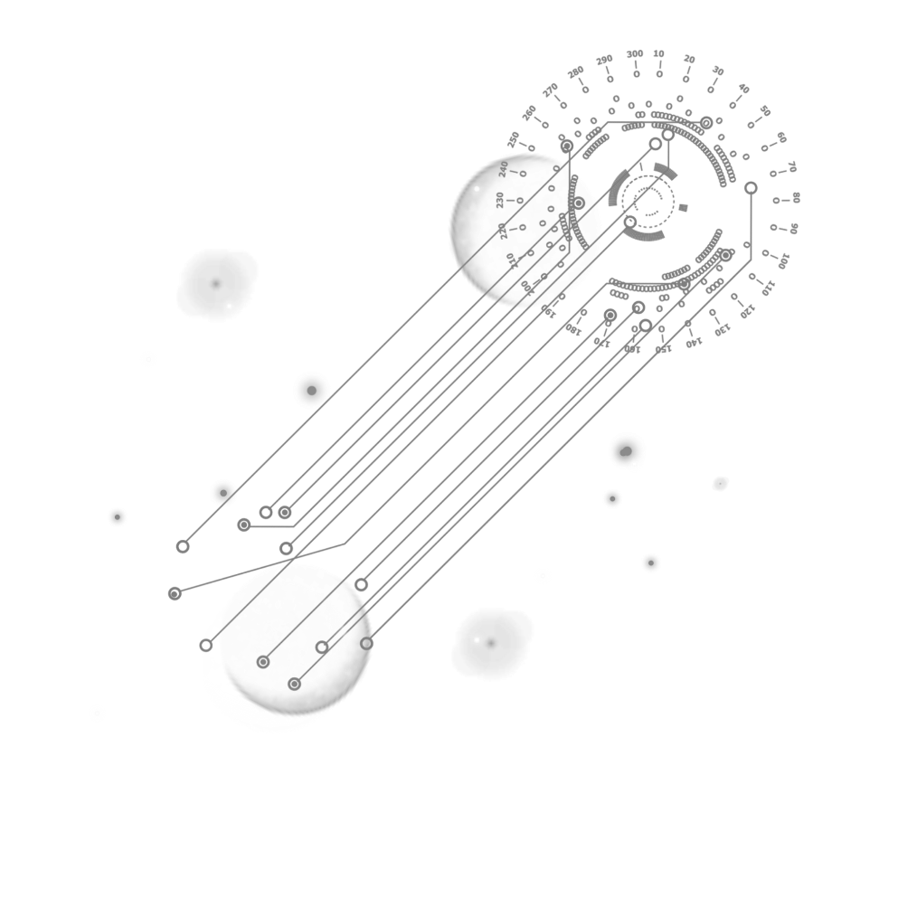
BUG
ISSUE
Problem definition
The top 10 most popular vulnerabilities on Ethereum right now
Study Ethereum's working procedures and find out potential problems, then clarify the cause and try to provide a possible solution. Engage in background material readings and help identify issues.

Slide 5


Objective
Simplify the smart contract security audit process and offer an automated tool for detecting common vulnerabilities.
Through deep integration with Slither, the platform is capable of quickly and accurately identifying Our primary objective in developing this platform was to simplify the smart contract security audit process and offer an automated tool for detecting common vulnerabilities.

Slide 6
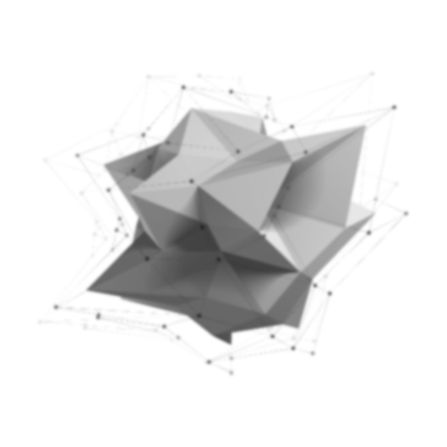

Ethereum Overview
Ethereum：
1. open-source, public blockchain platform with smart contract functionality
2. essentially a public database that keeps a permanent record of digital transactions
3. decentralised, de-trusted distributed ledger technology
4. chained structure consisting of data blocks, making data difficult to tamper with
Principles of operation：
1. the user sends a transaction or deploys a smart contract via a wallet
2. the network node validates and executes it in an Ethernet Virtual Machine (EVM)
3. the validation result is packaged into blocks and added to the blockchain
Smart contracts：
1. Written in a programming language, the execution of the record can not be tampered with
2. to ensure that the transaction is transparent and open and legal

Slide 7
Ethereum Overview
Hash Function：
collision resistance：Collision resistance means that in the current application it is impossible to have two plaintexts with the same hash value
Unidirectionality：Unidirectionality means that it is difficult to decrypt a ciphertext encrypted by a hash function into plaintext.
avalanche effect：The avalanche effect means that even if the plaintext changes slightly, the encrypted ciphertext will change significantly
Future Directions：
1.consensus mechanism
2.Blockchain sharding technology
3.layer2

Slide 8

Potential problems with Ethereum's mature smart contracts and their solutions
Integer Overflow and Underoverflow
This occurs when an arithmetic operation exceeds the maximum or minimum value that the variable can hold
Solution
Use the SafeMath library, which is widely adopted by the Ethereum community, to help prevent these issues by ensuring safe arithmetic operations.

Slide 9
Potential problems with Ethereum's mature smart contracts and their solutions
Regulatory and Legal Risks
Smart contracts operate in a relatively new and evolving regulatory landscape. Legal uncertainties can pose risks for both developers and users.
Solution
Staying informed about regulatory developments, engaging with legal experts, and considering compliance from the outset of contract development can help mitigate legal risks. Additionally, adopting decentralized governance models can distribute regulatory risk among a broader community.

Slide 10
Potential problems with Ethereum's mature smart contracts and their solutions
Front-running
This occurs when an attacker observes a pending transaction and places a similar transaction with higher gas fees to be mined first.
Solution
Techniques like commit-reveal schemes and adding randomness to transaction data can help prevent front-running. Layer 2 solutions and other off-chain mechanisms can also offer protection.

Slide 11
Potential problems with Ethereum's mature smart contracts and their solutions
Complexity and User Experience
Hard to understand technical details such as gas fees, transaction hashes, and cryptographic keys.
For non-technical users : Using these apps for the first time, they may not even know what they need to do to make a transaction and interact with smart contracts.
User Experience: User experience can have a key impact on the application, So it is important to design a user-friendly app.

Slide 12
Complexity and User Experience
Solution
Reduced Technical Details: Reducing some of the specialized and complex information about blockchain or providing clear documentation to assist users to use the dApp.
2. User-friendly UI
· Provide more obvious feedback.
It means displaying some key information the user is mainly concerned with on the user interface(purchase information, showing the user balance, price changes, transaction status, etc.)
· Easy for the user to learn what the blockchain is doing.
e.g. MetaMask, The detection Tool
Notes:
By the way,the detection tool we are going to show you later follows this idea as well, so this tool we design is as easy as possible for the user to understand how our detection tool works and enable to check the results of detectioon clearly and easily. The specific content will be shown later.

Slide 13
Potential problems with Ethereum's mature smart contracts and their solutions
Gas Fees
Fluctuating Gas prices make it difficult for users to predict transaction costs, which can trigger failed transactions or overpayments, affecting the user experience.
Solution
In order to optimise the Gas fee problem in Ethernet, the predictability of Gas fees can be improved by implementing Gas optimisation techniques in smart contracts, educating users on how to set appropriate Gas limits, and utilising the base fee model introduced by EIP-1559.

Slide 14
Potential problems with Ethereum's mature smart contracts and their solutions
Phishing and Social Engineering
Users may be tricked into interacting with malicious contracts or websites that appear legitimate.
Solution
Educating users about the risks of phishing, promoting security practices such as double-checking URLs, and using tools to warn users about unverified contracts can help reduce these risks.

Slide 15
Potential problems with Ethereum's mature smart contracts and their solutions
Security Breaches & Attacks - Re-entrancy attacks
The DAO hack incident is one example. In this type of attack, the malicious contract repeatedly calls back the vulnerable contract before the initial function is completed, resulting in a depletion of funds.
Solution
This risk can be mitigated by implementing a check-effect-interaction pattern, using re-entrancy protection like ReentrancyGuard in OpenZeppelin, and having a full audit of the contract.

Slide 16
Potential problems with Ethereum's mature smart contracts and their solutions
Scalability Issues
As the Ethereum network grows, scalability becomes a pressing concern. High demand can lead to network congestion, driving up gas fees and making transactions slow and expensive.
Solution
The Ethereum 2.0 upgrade aims to address scalability through the introduction of sharding
and a transition from Proof of Work (PoW) to Proof of Stake (PoS). Layer 2 solutions like Optimistic Rollups and zk-Rollups also promise to enhance scalability by processing transactions off-chain and settling them on-chain.

Slide 17
Potential problems with Ethereum's mature smart contracts and their solutions
Code Immutability
Once deployed, smart contracts on Ethereum are immutable, meaning they cannot be altered. This immutability can be a double-edged sword; while it ensures trustlessness and security, it also means that bugs and vulnerabilities cannot be easily fixed.
Solution
Implementing upgradeable contract patterns, such as the Proxy pattern, allows developers to introduce new logic while maintaining the same contract address. Rigorous testing, peer reviews, and professional audits before deployment are also crucial.

Slide 18
Potential problems with Ethereum's mature smart contracts and their solutions
Oracles and external data dependencies
Smart contracts often rely on external data sources (oracles) to execute functions based on real-world events. If an oracle is compromised, it can lead to incorrect or malicious contract behavior.
Solution
Using decentralized oracles like Chainlink can reduce the risk of a single point of failure. Ensuring that multiple oracles are used and implementing fallback mechanisms can provide additional security.

Slide 19
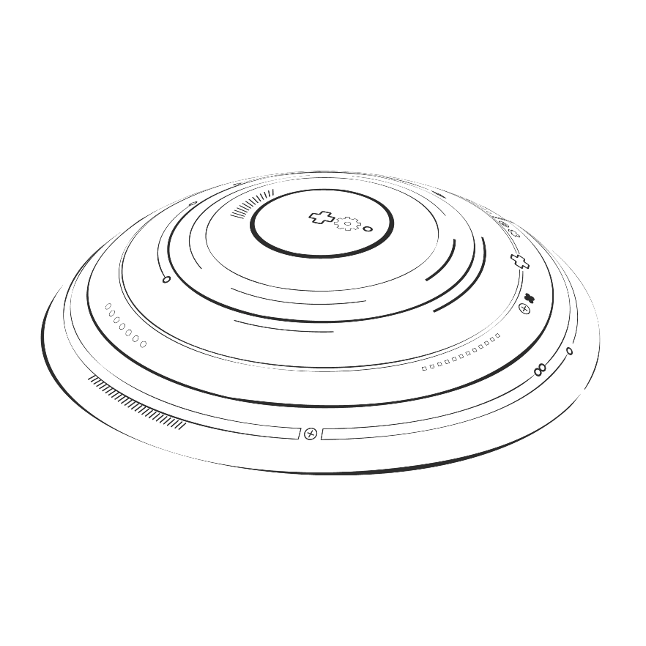
Summary
· Mature smart contracts on Ethereum provide innovative solutions to traditional centralized systems, but they also face many challenges.
· Addressing security vulnerabilities through best practices and audits, leveraging Ethereum 2.0 and Layer 2 solutions to improve scalability, improve availability, comply with regulations, manage code immutability, and securely integrate oracles are key steps in mitigating potential issues.
· As the ecosystem grows, continuous improvement and vigilance will be key to realizing the full potential of smart contracts.

Slide 20
Part 2
Solution Design

Slide 21
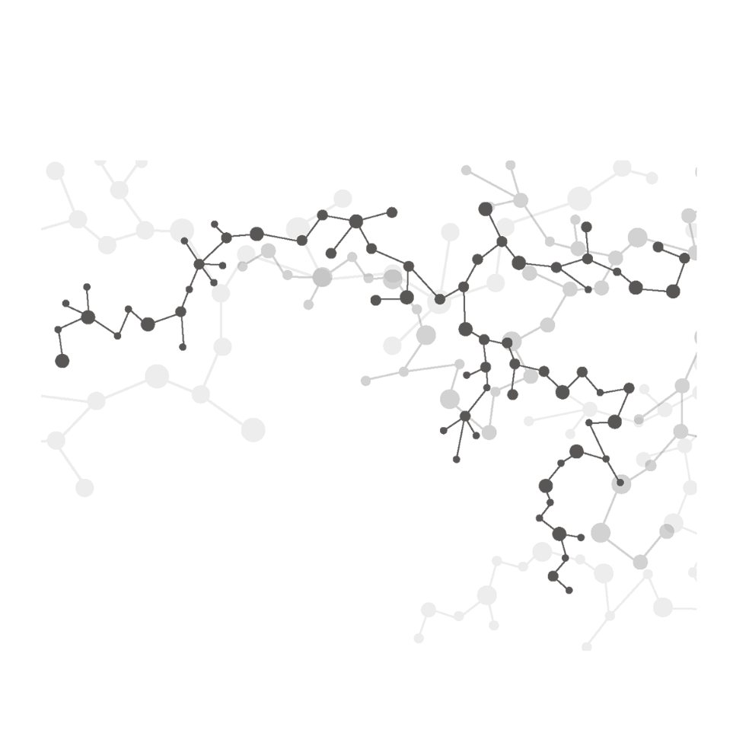
Operating Procedure
Smart contract code reproduction
Phase I
IMPLEMENTATION
Substitution for vulnerability detection
Phase II
Bug fixes and bug improvements
Phase III

Slide 22

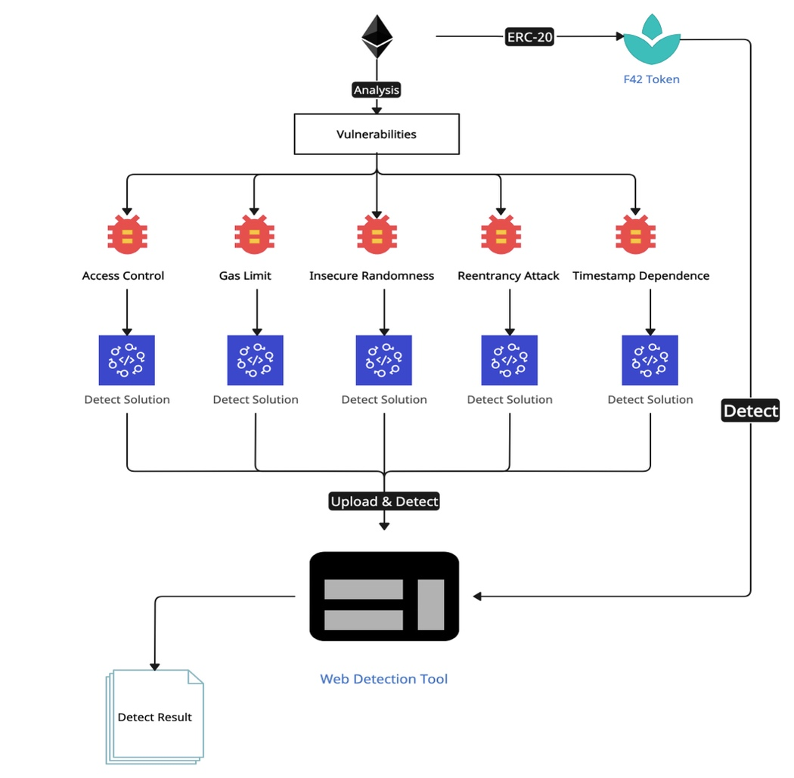
Project workflow

Slide 23
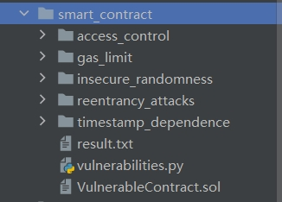
Smart contract reproduction
1. Find a smart contract with a vulnerability (corresponding to the file on GitHub)
2. Write a first-generation smart contract

Slide 24
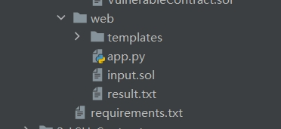
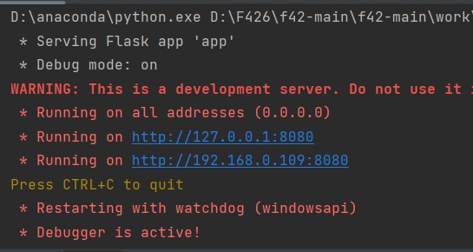
Code Instrumentation Tool (Find Vulnerabilities)
Execute programme

Slide 25
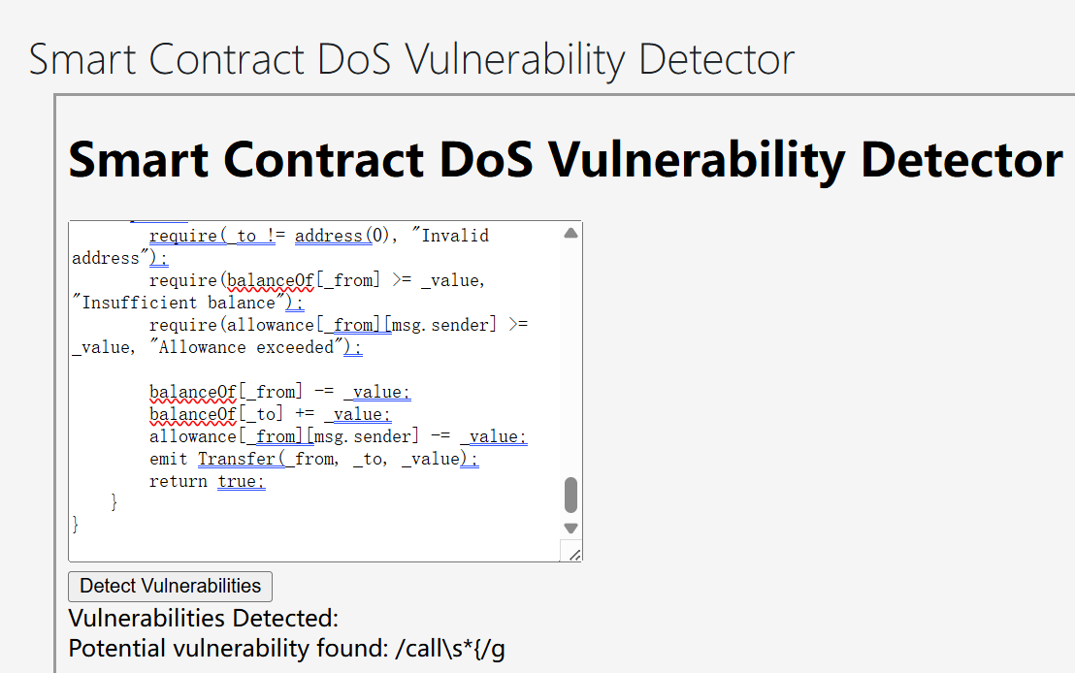

Fix bugs
Follows ERC-20 standards Develop a proposed cryptocurrency
https://github.com/RockyRori/f42.git
See what's wrong with this simple cryptocurrency under the ERC-20 standard Check using the tools provided by the teacher during the lesson
https://lms.ln.edu.hk/mod/resource/view.php?id=739976
Check in turn according to the documents provided by the teacher
https://github.com/OWASP/www-project-smart-contract-top-10/tree/main/2023/en/src

Slide 26
Part 3
Implementation
& Deployment

Slide 27
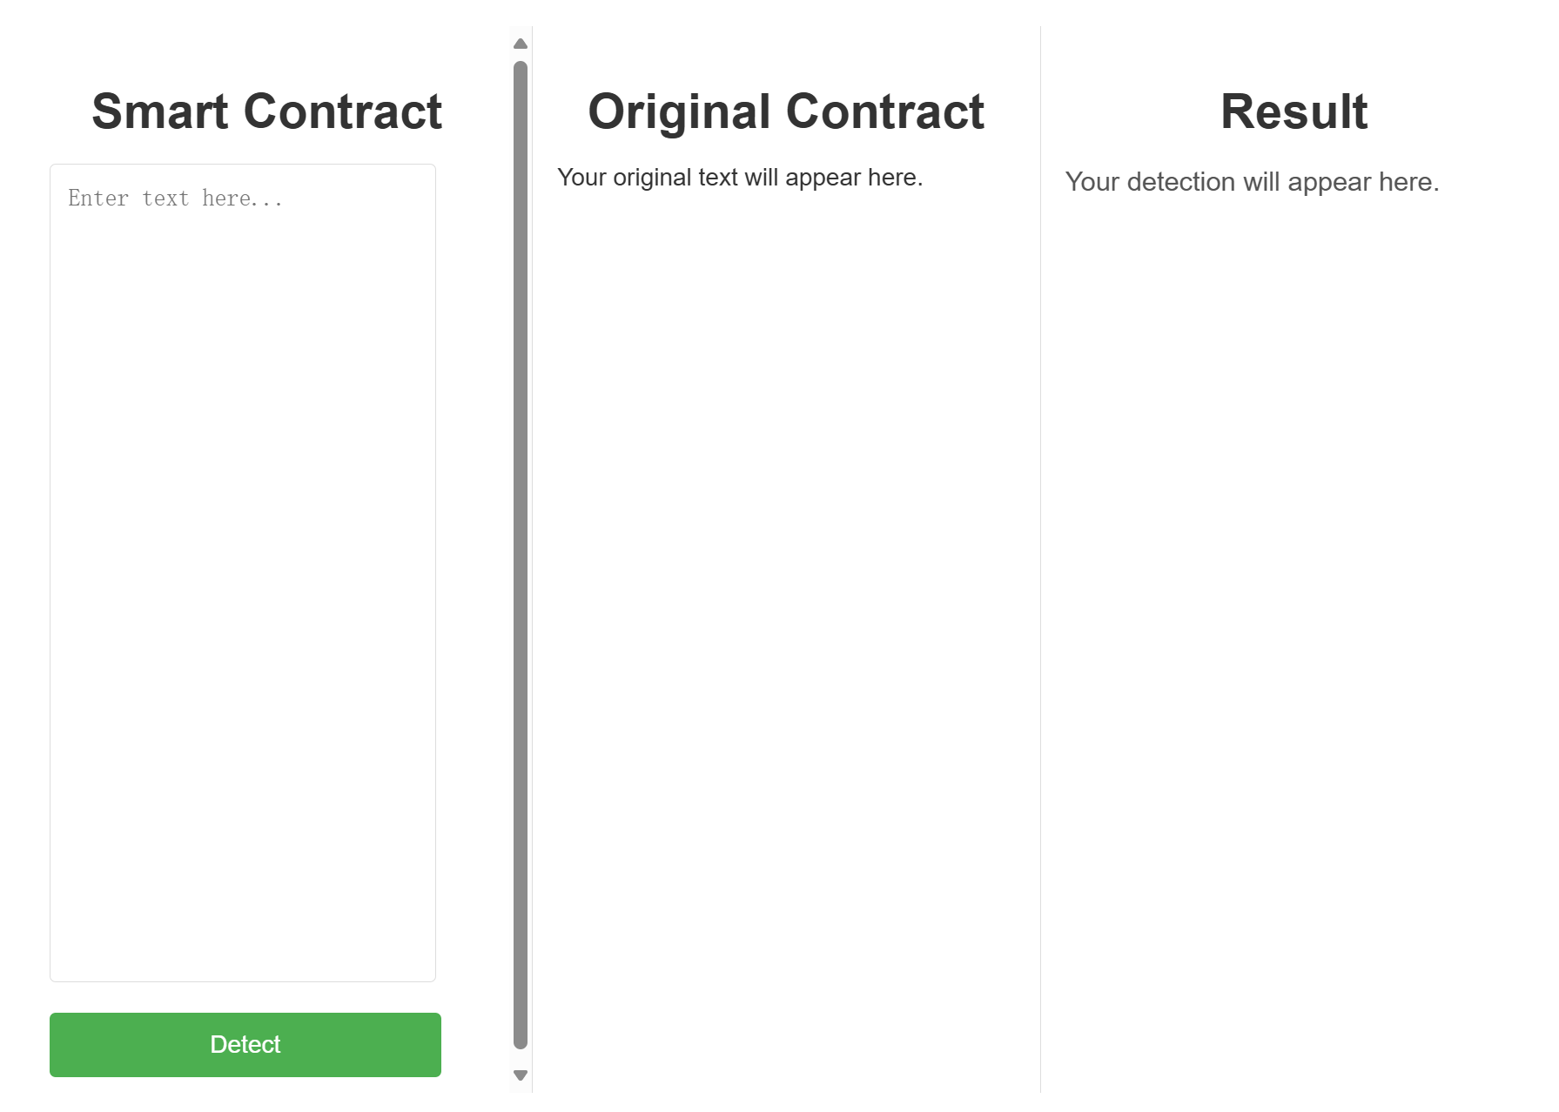
Enter the contract on the web
There are 3 sections on our website, on the left side you can enter the smart contract that needs to be detected, after clicking on detect the original smart contract that we entered will be displayed in the middle, and in the result section the results of the detection will be displayed. The output clearly shows how many vulnerabilities have been detected and on what line they appear, with a link to github as a reference to the vulnerability.

Slide 28
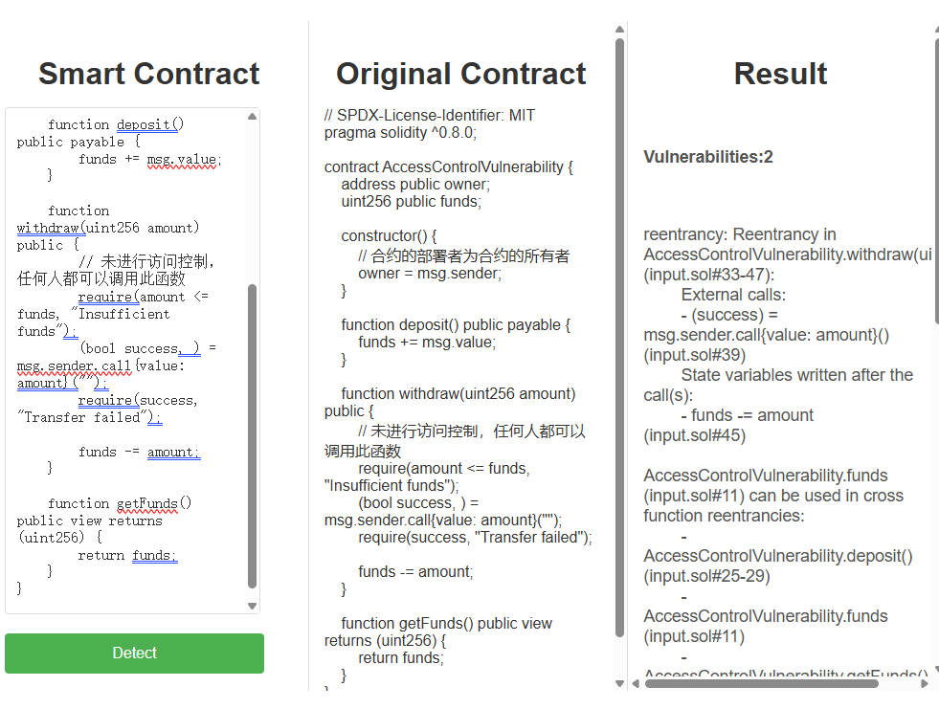
Access Control

Slide 29
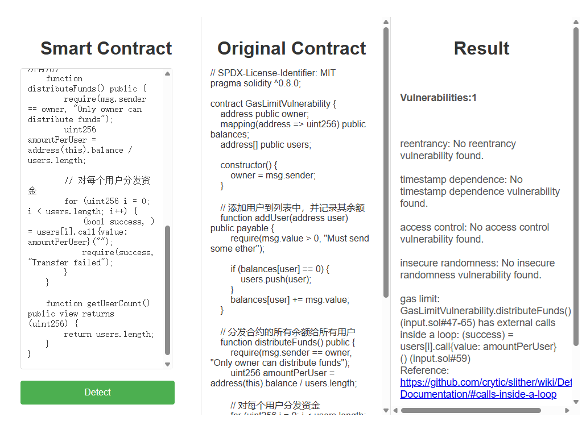
Gas Limit

Slide 30
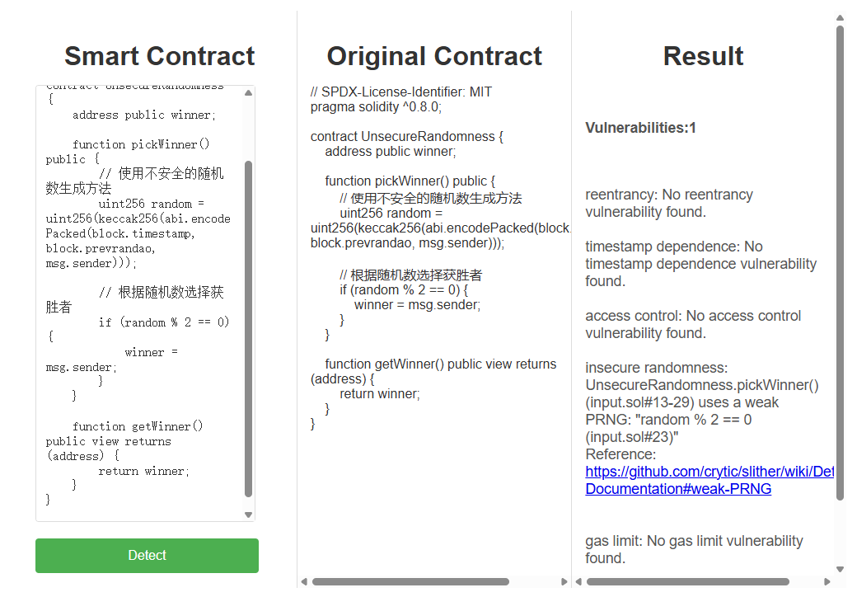
Insecure Randomness

Slide 31
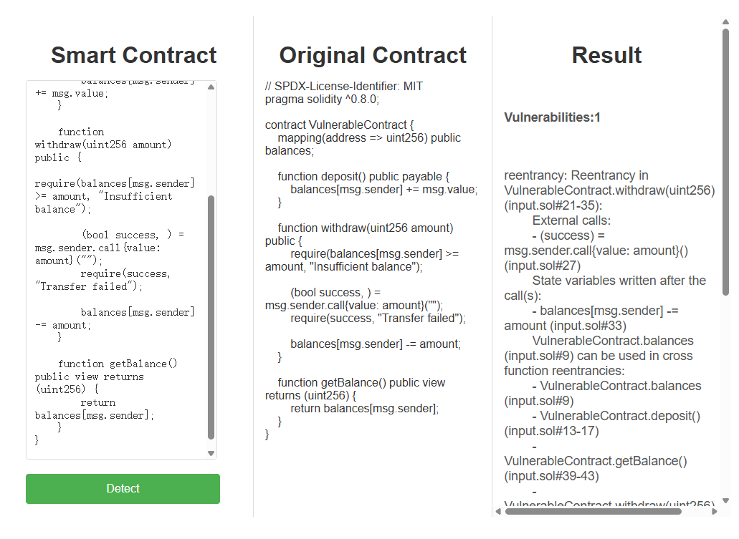
Reentrancy Attack

Slide 32
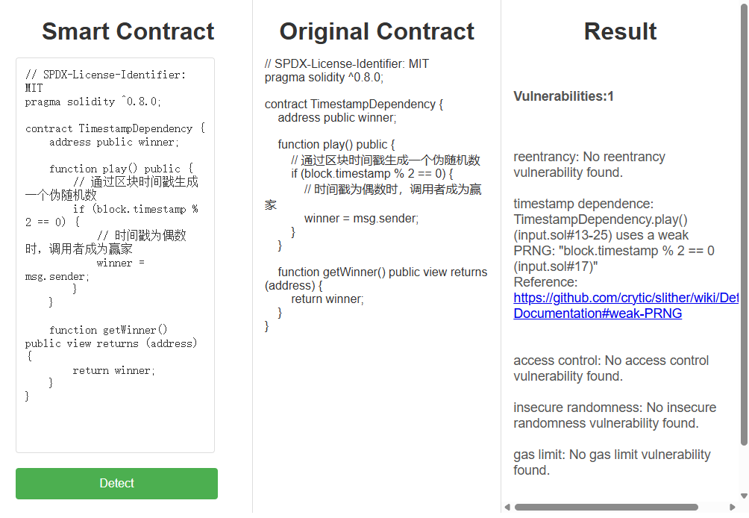
Timestamp Dependence

Slide 33
Conclusion
Vulnerability Detection Platform We designed and implemented a vulnerability detection platform for Solidity smart contracts based on the Flask web framework. By integrating the powerful Slither static analysis tool, our platform can automatically detect common security vulnerabilities in user-uploaded Solidity smart contracts. Through this platform, we aim to provide a convenient and efficient tool to identify potential security issues in smart contracts.
Platform Objective Our primary objective in developing this platform was to simplify the smart contract security audit process and offer an automated tool for detecting common vulnerabilities. Through deep integration with Slither, the platform is capable of quickly and accurately identifying typical security risks in smart contracts, helping developers uncover and fix these issues early to ensure the security of their contracts.

Slide 34
Future Outlook
We plan to continue to improve the platform's functionality, expand its detection capabilities, and optimize the user experience. Provide security for smart contract development.
BrokerChain and its ecosystem:
There are three main directions of development:
Running time technology
1.Efficiency
2.Optimization for parameters
3.New consensus, cross - chain protocols
Core modules
Broker Virtual Machine
Ecosystem
Building & maintaining
More dApps.

Slide 35
Benefits
Incentives for users to participate in Web3 (incentives for users to participate in Web3)
1.TPS improvement when increasing the number of slices;
2.Lower latency as transaction arrival rates change;
3. Reduce the number of cross-chain transactions;
4. Increased blockchain throughput;
5.Significant performance improvement.

Slide 36
Literature References
& Bibliography
REFERENCE DOCUMENTATION
Ethereum Whitepaper | ethereum.org
https://ethereum.org/en/whitepaper/#a-next-generation-smart-contract-and-decentralized-application-platform
Ethereum Price, Chart, Market Cap, ETH Coin Essentials | CoinLore
https://www.coinlore.com/coin/ethereum
Introduction to Smart Contracts — Solidity 0.8.28 documentation
https://docs.soliditylang.org/en/v0.8.28/introduction-to-smart-contracts.html
inoutcode/ethereum_book
https://github.com/inoutcode/ethereum_book
ethereum - Google Scholar
https://scholar.google.com/scholar?hl=en&as_sdt=0%2C5&q=ethereum&btnG=

Slide 37

Thanks for watching
F426

